Slide 1
VAC 25
Value-driven leadership

Slide 2
Table of contents
01
05
02
06
07
Morals and Values
Character
Civility and Community
Ethics
Trust and Integrity
Conflict
03
04
Justice and Fairness

Slide 3
COURSE SYLLABUS
Unit 1: Introduction and Resolving Conflicts of Values within and between other Stakeholders
Introduction to Concepts like Morals, Values, Ethics, Trust, Integrity, Justice, Fairness, Community, Civility and Community, Conflicts, and Stakeholders. Issues of Conflicts. Resolving Conflicts of Values within and between other Stakeholders.
Unit 2: Workforce Diversity and Corporate Social Responsibility
Diversity, Types of Diversity, Benefits of Workforce Diversity. Corporate Social Responsibility. Milton Friedman's Approach, Companies Act and Corporate Social Responsibility
Unit 3: Managing Values through Incentives and Informal Mechanisms
Managing Values, Incentives, Material Incentives, Informal Mechanisms, Managing Values through Incentives and Informal Mechanisms
Unit 4: Speaking the Truth and Values Based Marketing
Truth, Unethical Behaviour, Situations where Truth is dangerous for the organization, Importance of Speaking the Truth. Ethical implications of Marketing Values, Importance of Values Based Marketing. Thomas Donaldson's Ethical Algorithm
Unit 5: Building Social Capital
Social Capital, Constituents of Social Capital, Importance of Social Capital for an Organization, Use Organizational Intellectual Capital to Create Value

Slide 4
UNIT 1

Slide 5
Morals and Values
Ethics
Trust and Integrity
Character
Civility and Community
According to Charles Colson, “Morality describes what is, whereas Ethics describes what ought to be”.
Morals and values are a part of a person’s behaviour.
Fundamentally, morals refer to a set of rules defining what is considered to be right or wrong and accepted without questions. They are formed from inborn values, a system of beliefs typically defined by society’s rules. If someone breaks such a rule then he is typically considered to have been “bad” or “immoral.”
Values, on the other hand, provide direction in the determination of right versus wrong or good versus bad. Values are personal beliefs that worth and importance to an individual. These are emotionally related for deciding right or wrong.
Morals have more social value and acceptance than values, therefore a person is judged more for his moral character than the values. A person without moral is considered immoral but no such term exists for a person without values.
Justice and Fairness

Slide 6
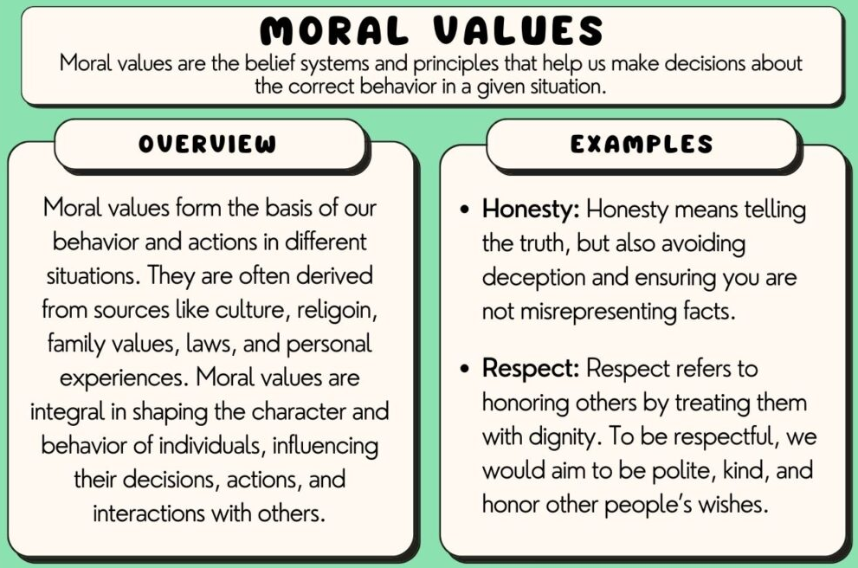
Morals and Values
Ethics
Trust and Integrity
Character
Civility and Community
While morals are generally the same for a culture, values, due to their individuality, tend to be highly subjective. Morals are often driven by values but governed by the rules of a particular culture.
Justice and Fairness

Slide 7
Morals and Values
Ethics
Trust and Integrity
Character
Civility and Community
Ethics are a set of beliefs or understanding of a morally right philosophy dictating behaviors that are encouraged or discouraged. These work as practical motivators for people to take up what is commonly believed to be the right or ideal path. The concept of ethics reflects the evolution of morals into a socially and professionally accepted category.
The etymology of the word can be traced to the Greek word ethos, which translates into 'custom', thus conveying the social value attached to it ever since. The academic study of ethics has a historic study, ranging from mythology to the serious accounts of Aristotle, scholars have critically differentiated right from wrong in this domain.
Ethics is a moral and normative science. It covers the following dilemmas:
          How to live a good life
    Our rights and responsibilities
    The language of right and wrong
    Moral decisions - what is good and bad?
Justice and Fairness

Slide 8
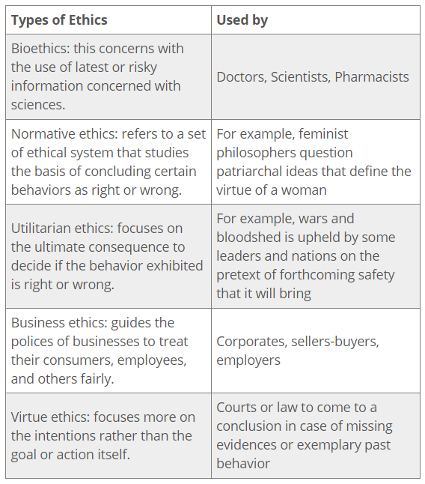
Morals and Values
Ethics
Trust and Integrity
Character
Civility and Community
Ethics have evolved into concepts beyond their academic or philosophical study.
They are now looked at as pragmatic and morally defined expected/unexpected behaviors of people in various professions and walks of life.
As such, there are various types of ethical codes –
Justice and Fairness

Slide 9
Morals and Values
Ethics
Trust and Integrity
Character
Civility and Community
MAJOR PRINCIPLES OF ETHICS –
Beneficience – Decision makers should prioritize doing what is right and what is good. Ethical theories should strive to achieve the greatest amount of good (over evil).
Non-maleficence or Least Harm – In situations where there is no clear ethical solution, decision makers should seek to choose to do the least harm possible.
Respect for Autonomy – Decision making should focus on allowing people to be able to make decisions that apply to their lives. People should have control over their lives as much as possible. Other principles that spring from autonomy include – informed consent, honesty, and confidentiality.
Justice – Decision makers should focus on actions that are fair to those involved and be consistent with the ethical theory unless extenuating circumstances can be justified.
Accountability – Decision makers should accept responsibility and consequences for their own actions.
Fidelity – Decision makers should abide by their promises and be faithful.
Veracity – Decision makers should be true to themselves and to others.
Justice and Fairness

Slide 10
Morals and Values
Ethics
Trust and Integrity
Character
Civility and Community
THEORIES OF ETHICS –
Deontology - Immanuel Kant, W.D. Ross
People should adhere to their obligations and duties when engaged in ethical decision making, i.e, they should uphold their duty. However, the flaw in this theory is that there is no rationale or logical basis for deciding ones individual duties. Further, duties might bring conflict, especially when professional and personal lives clash.
Rights Theory – Aristotle, Confucius
In ethical theories based on rights, the rights established by a society are protected and given the highest priority. Rights are considered ethically correct and valid since they are endorsed by a large population. Individuals may also bestow rights upon others if they have the ability and resources to do so. A major complication of this theory on a larger scale is that we must decipher the characteristics of a society’s rights. The society has to determine what rights it wants to uphold and give to its citizens and to do that, it must decide what the society’s goals and ethical priorities are. Therefore, for the rights theory to be useful, it must be used in conjunction with another ethical theory that will consistently explain the goals of the society
Justice and Fairness

Slide 11
Morals and Values
Ethics
Trust and Integrity
Character
Civility and Community
Utilitarianism - Jeremy Bentham, J.S. Mill
According to this theory, ethical decision making is based on one’s ability to predict consequences of an action. The choice that yields the greatest benefit to the most people is considered ethically correct. There are 2 types of utilitarianism – ACT and RULE. Act Utilitarianism conforms to the idea that one should perform an act that benefits most people, regardless of personal feelings or societal constraints such as laws. Rule Utilitarianism seeks to benefit most people through the fairest and most just means available. A disadvantage of utilitarianism is that although people can use their life experiences to predict outcomes, no one can ascertain the accuracy. Uncertainty tends to lead to unexpected results, making the decision maker appear unethical.
Virtue
The virtue ethical theory judges a person by his/her character rather than by an action that may deviate from his/her normal behavior. It takes the person’s morals, reputation, and motivation into account when rating an unusual and irregular behavior that is considered unethical. One weakness of virtue ethical theory is that it does not take into consideration a person’s change in moral character.
Justice and Fairness

Slide 12
Morals and Values
Ethics
Trust and Integrity
Character
Civility and Community
Care Ethics - Carol Gilligan, Virginia Held
The theory states that what makes something good or bad, right or wrong, is that it involves caring for another, and supports relationship with other people. Care Ethics functions on the basic principle of caring towards those who are vulnerable or need support. One should chose the action which supports or nurtures other people, particularly those who are most vulnerable (e.g. children, economically unstable households etc.). However, this theory is often viewed as supplement to other ethical theories, rather than as comprehensive theory in its own right.
Egoism Theory – Ayn Rand, Adam Smith
According to this theory, what makes something good or bad, right or wrong, is that it satisfies one’s desires, or meets one’s needs. The theory propagates the principle of Self-interest of the decision maker. doing, considering, or affected by the action. One should chose the action which most realizes or conduces to one’s own self-interest. A variation to this theory asks if the person should look simply to self-interest, or to enlightened or rational
self-interest?○ Conception of Rational Self-Interest is basic component of capitalist economy and business models.
Justice and Fairness

Slide 13
Morals and Values
Ethics
Trust and Integrity
Character
Civility and Community
ETHICS AND VALUES IN THE INDIAN CONTEXT – KAUTILYA’S ARTHASHASTRA
Evidence of the modern administrative character of the Arthashastra comes most through Kautilyas’ expressions of efficiency, described in a unique imagery of corrupt officials improperly eating the wealth of the state.
Kautilyas’ concept of efficiency depends on an extensive elaboration of efficiency-guaranteeing techniques. He creates makes a clear link between civil service malfeasance and the reduction in wealth. Contravening the standards of efficiency was among the highest ills that a civil servant could commit in his state. Kautilya believed that “men are naturally fickle minded” and are comparable to “horses at work who exhibit constant change in their temper”. This means that honesty is not a virtue that would remain consistent life long and the temptation to make easy gains through corrupt means can override the trait of honesty any time. Similarly, he compared the process of generation and collection of revenue by officials with honey or poison on the tip of the tongue, which becomes impossible, not to taste.
Justice and Fairness

Slide 14
Morals and Values
Ethics
Trust and Integrity
Character
Civility and Community
Vigilance and Transparency – Kautilya prescribed a strict vigil even over the superintendents of government departments in relation to the modus operandi of work. He reflected serious concerns about opacity in the operations of the world of the corrupt. Illegal transactions were so shrouded in mist that he compared embezzlers to fish moving under water and the virtual impossibility of detecting when exactly the fish is drinking water. He also noted that while it is possible to ascertain the movements of bird flying in the sky, it is difficult to gauge the corrupt activities of government officials.
40 kinds of embezzlement – In all these cases, the concerned functionaries such as the treasurer, the receiver, the payer, the person who caused the payment and the ministerial servants were to be separately interrogated. In case any of these officials were to lie, their punishment was to be enhanced to the level meted out to the chief officer mainly responsible for the crime. After the enquiry, a public proclamation was to be made asking the common people to claim compensation in case they were aggrieved and suffered from the embezzlement.
Justice and Fairness

Slide 15
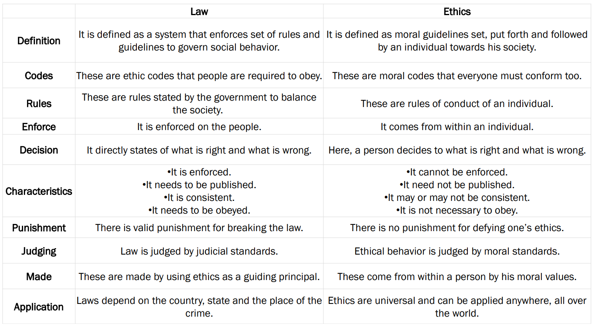
Morals and Values
Ethics
Trust and Integrity
Character
Civility and Community
Justice and Fairness

Slide 16
Morals and Values
Ethics
Trust and Integrity
Character
Civility and Community
ETHICS IN THE WORKPLACE –
Workplace ethics – often called business ethics – are the set of moral principles, values, and standards that both employees and employers follow in the workplace.
At its core, ethics in the workplace is the moral code that guides employees concerning what is wrong and right conduct.
Companies should publish in-house codes of ethics to be strictly followed by all their associates and employ people with a reputation for high standards of ethical behaviour at the top levels.
Incorporate consideration of ethics into performance reviews. Reward ethical behaviour.
SEBI, CII and such other organizations representing corporations issue codes of best practices and enjoin their members to observe them.
Ethics-based curriculum.
Conduct an ethics audit.
Justice and Fairness

Slide 17
Morals and Values
Ethics
Trust and Integrity
Character
Civility and Community
Integrity means doing the right thing in the right way; it means adhering to values strongly held. Trust is a belief that someone is honest and credible; trust is earned by being honest, having a positive intent, having strong competencies, and a track record of results.
Integrity in leadership is often equated with courage- courage to speak up when your point of view is at odds with a manager’s perspective or with a commonly held belief about how things should be done. Integrity may also be interpreted as work ethic- in early, staying late to get the right things done for the company.
Trust may be based on a feeling that you have the other person’s back when he or she is not in the room. It may be the confidence you will advocate the other person’s point of view with clarity and understanding. Or, trust may be gained as you’re seen to act in the best interest of the team or organization rather than acting primarily to advance your personal agenda.
The combination of the two creates character, both good and bad.
We judge ourselves by our intentions, while people judge us by our actions.
Justice and Fairness

Slide 18
Morals and Values
Ethics
Trust and Integrity
Character
Civility and Community
Leaders skilled in Integrity & Trust -
Keep their promises
Have a reputation for being honest and forthright
Do not present opinions as facts
Are consistent in words and actions
Trust and respect others
Do respond to pressure to act in conflict with their ethics
Understand that trust must be earned
Keep information shared in confidence private
Accept responsibility for their mistakes
Lead by example, not by dictates alone
Maintain transparency
Deliver amount and quality promised, or over deliver
Always try to do the right thing
Justice and Fairness

Slide 19
Morals and Values
Ethics
Trust and Integrity
Character
Civility and Community
What prevents Integrity & Trust?
Lack of actual commitment to keep promises
Making excuses or blame others for their mistakes
Inconsistency in following through
Dishonesty, especially for gain
Blunt, compassionless frankness
Takes responsibility for mistakes
Lack of transparency
Under-delivering on quantity or quality
Inconsistency between words and actions
Gossiping and divulging information shared in confidence
Making unrealistic promises
Demonstrated lack of faithfulness to stated values
Selfishness
Inclination to judge others negatively
Justice and Fairness

Slide 20
Morals and Values
Ethics
Trust and Integrity
Character
Civility and Community
Justice means giving each person what he or she deserves or, in more traditional terms, giving each person his or her due.
Justice and fairness are closely related terms that are often today used interchangeably. There have, however, also been more distinct understandings of the two terms. While justice usually has been used with reference to a standard of rightness, fairness often has been used with regard to an ability to judge without reference to one's feelings or interests; fairness has also been used to refer to the ability to make judgments that are not overly general but that are concrete and specific to a particular case. In any case, a notion of being treated as one deserves is crucial to both justice and fairness.
The most fundamental principle of justice, as defined by Aristotle, is the principle that "equals should be treated equally and unequals unequally." In its contemporary form, this principle is sometimes expressed as follows: "Individuals should be treated the same, unless they differ in ways that are relevant to the situation in which they are involved."
Justice and Fairness

Slide 21
Morals and Values
Ethics
Trust and Integrity
Character
Civility and Community
Character applies to the aggregate of moral qualities by which a person is judged apart from intelligence, competence, or special talents.
The word comes from the Greek word kharakter for “engraved mark,” “symbol or imprint on the soul,” and “instrument for marking,” and can be traced further back to the words for “to engrave,” “pointed stake,” and “to scrape and scratch.”
Character is nature and nurture. It is nature cultured and disciplined, so that natural tendencies are brought under the sway of the moral motive.
There are 3 qualities of true character –
Moral discipline
Moral attachment
Moral autonomy
Character gains through its expression, and loses through its repression.
Justice and Fairness

Slide 22
Morals and Values
Ethics
Trust and Integrity
Character
Civility and Community
Civility represents the quality of our behavior with others in our communities. This is important for business because how we treat others signals who we are and what we value. Moreover, since the essence of ethics lies in how we are with others, civility and ethics are intricately linked.
Civility is not peripheral to ethics, and essential to defining the culture and establishing a foundation of proper business behavior. It is an underlying value that successful organizations strive to achieve.
There are 3 basic principles to create a civil workplace –
Respect: Inherent in the belief that although another person’s beliefs may be different than yours, you should still honor their viewpoint and accord the other person due consideration.
Restraint: Exercising personal self-control at all times.
Refinement: For continual cultivation and improvement of relationships in the workplace.
Justice and Fairness

Slide 23
CONFLICT
Conflict is defined as a clash between individuals arising out of a difference in thought process, attitudes, understanding, interests, requirements and even sometimes perceptions.
A conflict not only can arise between individuals but also among countries, political parties and states as well. Types of conflict – task, relationship and process.
Prelude to conflict - It involves all the factors which possibly arise a conflict among individuals. Lack of coordination, differences in interests, dissimilarity in cultural, religion, educational background all are instrumental in arising a conflict.
Triggering Event - No conflict can arise on its own. There has to be an event which triggers the conflict.
Initiation Phase - Initiation phase is actually the phase when the conflict has already begun. Heated arguments, abuses, verbal disagreements are all warning alarms which indicate that the fight is already on.
Differentiation Phase - It is the phase when the individuals voice out their differences against each other. The reasons for the conflict are raised in the differentiation phase.
Resolution Phase - A Conflict leads to nowhere. Individuals must try to compromise to some extent and resolve the conflict soon.

Slide 24
TYPES OF CONFLICT
Intrapersonal conflict
  Conflict experienced by a single individual, when his or her own goals, values or roles diverge
Interpersonal conflict
  Conflict due to differences in goals, value, and styles between two or more people who are required to interact.
Intragroup conflict
  Conflict within a group or team, where members conflict over goals or procedures.
  Conflict between groups inside and outside an organization disagree on various issues. Conflict can also arise between two groups within the same organization, and that also would be considered intergroup conflict.
  Within those types of conflict, one can experience horizontal conflict, which is conflict with others that are at the same peer level as you, or vertical conflict, which is conflict with a manager or a subordinate.
Intergroup conflict

Slide 25
CAUSES OF CONFLICT
OUTCOMES OF CONFLICT
Organizational Structure
Positive outcomes
Consideration of a broader range of ideas, resulting in a better, stronger idea
Limited Resources
Surfacing of assumptions that may be inaccurate
Task Interdependence
Increased participation and creativity
Incompatible Goals
Clarification of individual views that build learning
Personality Differences
Negative outcomes
Increased stress and anxiety among individuals, which decreases productivity and satisfaction
Communication Problems
Feelings of being defeated and demeaned, which lowers individuals’ morale and may increase turnover
Contrasting Styles
A climate of mistrust, which hinders the teamwork and cooperation necessary to get work done
Cultural and Gender Differences

Slide 26
CONFLICT MANAGEMENT - Thomas-Kilmann Conflict Mode Instrument
ACCOMMODATING
Forsake own needs or desires in exchange for those of others.
Put concerns of others before your own. This style usually takes place when you simply give in or are persuaded to give in.
Appropriate when others care more about the issue than you do, want to keep the peace, feel you are in the wrong, or have no choice but to agree with the other person’s point-of-view.
AVOIDING
To completely evade the conflict. You would neither pursue your beliefs nor those of the other people involved. Simply, you would continuously postpone or completely dodge the conflict whenever it comes up.
Appropriate to use when the conflict seems trivial, you don't have the time, you need more time to think, you feel as though you have no chance of winning, or you're afraid of being met with resentment.
COMPROMISING
Attempts to find a solution that will at least partially please all parties. You work to find a middle ground between all the needs, which would typically leave people unsatisfied or only satisfied to a certain extent.
Appropriate when it's more important to reach a solution than for the solution to be great, a deadline is rapidly approaching, you're at an impasse, or you need a temporary solution for the moment.
COLLABORATING
Attempts to find a solution that will meet the needs of all parties. Rather than trying to find a middle ground solution, you would aim for a solution that satisfies everyone and ends up being a win-win situation.
Appropriate when multiple perspectives need to be addressed, there is an important relationship between the parties, the final solution is too important for anyone to be displeased, or the beliefs of multiple stakeholders must be represented.
COMPETING
Takes a firm stance and refuses to see the perspectives of the other parties. You would keep pushing your viewpoint or rejecting other people’s ideas until you get your way.
Appropriate when you have to stand up for your rights or morals, need to make a quick decision and force others to get on board, need to end a long-term conflict, or have to prevent a terrible, opposing decision from being made.

Slide 27

THANK
YOU

